Slide 1
Project Milestone 3 Presentation
Course: ENGR 413 | AI in Engineering | Fall 2025
Team Members:
Kavin Krishnakumar (924296929),
Ratchagan Pandiyan (924369976)

Slide 2
Introduction (Real-World Motivation)
The Need for Smart Energy Scheduling
Residential electricity demand is increasing due to EV charging, HVAC systems, and appliances.
Power utilities use Time-of-Use (TOU) pricing, where electricity costs vary by hour.
Households often operate appliances without considering price changes → higher electricity bills.
Manual scheduling is impractical because:
  User habits vary.
  Appliances have constraints (windows, durations, sequences).
  Cost optimization depends on future load.

Slide 3
Problem Definition
Goal
Create an intelligent energy management system that:
Predicts household electricity demand.
Uses the prediction to optimally schedule appliances.
Minimizes electricity bills while satisfying real-world constraints.
Why This Problem Matters
Reduces energy waste.
Saves cost under TOU pricing.
Prepares households for smart grid integration and demand response.

Slide 4
Project Objectives & Scope
Objectives
Build a forecasting model (LSTM) to predict the next 24 hours of aggregate power.
Develop a scheduling optimizer (MILP) that uses the forecast to minimize cost.
Include realistic constraints (power cap, precedence, allowed windows).
Evaluate savings, peak demand, and system feasibility.
Scope
Dataset: UK-DALE House 1.
Appliances modeled: Washer, Dryer, EV Charging.
Scheduling horizon: 24 hours.
TOU tariff and user-defined constraints.

Slide 5
Background & Related Work
Prior Literature Findings
LSTM networks outperform classical models (ARIMA, linear regression) in electricity forecasting due to their ability to capture long-term dependencies.
Household scheduling research typically uses:
  Heuristics (shift to cheapest hour)
  Genetic algorithms
  Basic rule-based systems
  → But these do not guarantee optimality.
Gap
Few works directly combine deep learning forecasts with MILP optimization for a fully automated energy management system.

Slide 6
Dataset Description (UK-DALE)
Dataset Summary
Source: UK Domestic Appliance-Level Electricity dataset (public).
House 1: ~1-year worth of power data at 1-minute resolution.
Columns used:
  timestamp
  aggregate power (Watts)
Preprocessing
Converted timestamp → datetime.
Handled missing values by interpolation.
Converted Watts → kW for cost computation.
Extracted time features: hour, day of week, month.
Sorted chronologically.

Slide 7
Data Splitting & Normalization
Data Split
Train: 60%
Validation: 20%
Test: 20%
Split controlled by date indices.
Scaling
StandardScaler fitted only on training features.
Prevents data leakage.
Same scaler reused during inference.
Artifacts Saved
scaler.pkl
train_idx.csv, val_idx.csv, test_idx.csv

Slide 8
System Pipeline (Workflow Diagram)
Raw Data
Train LSTM Forecast Model
Compute KPIs (Cost, Peak, Savings)
MILP Optimization
Predict Next 24 Hours
Generate Appliance Schedule
Preprocessing & Scaling
Why This Pipeline
Splits forecasting and scheduling (modular).
Allows the scheduler to work with any demand prediction model.

Slide 9
LSTM Model Architecture
Model Details
Input window: 168 hours (7 days).
Output horizon: 24 hours.
Architecture:
  1 × LSTM Layer (64 hidden units)
  Dense layer → 24 outputs
Loss: MSE
Optimizer: Adam (lr = 0.001)
Batch size: 64
Epochs: 20
Framework: PyTorch
Why LSTM?
Captures temporal patterns in daily energy usage.
Handles seasonality (weekday/weekend cycles).

Slide 10
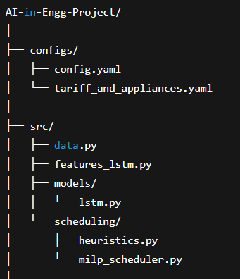
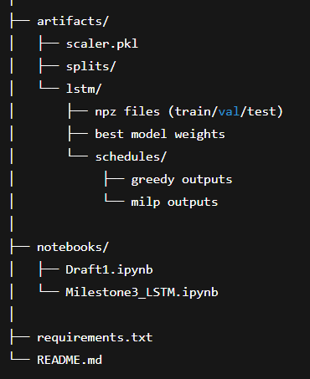
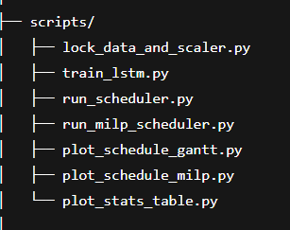
Project Directory Structure

Slide 11
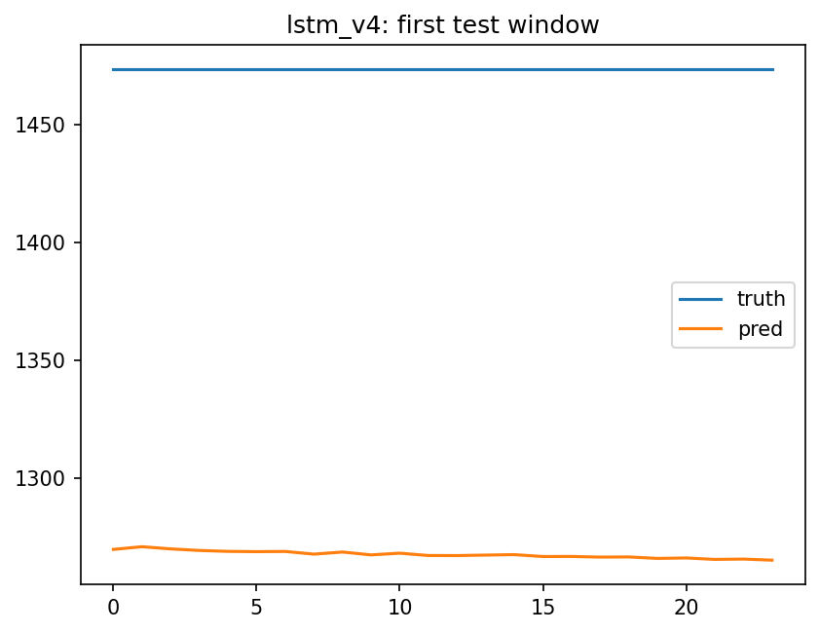
Forecast Example (Model Output)
LSTM 24-h Prediction vs Actual
Interpretation
Forecast follows daily trend (morning peaks, evening spikes).
Acceptable error margin for scheduling tasks.
Good enough for downstream MILP optimization.

Slide 12
MILP Scheduler (Formulation)
Optimization Goal
Minimize:
Total Cost = Σ (Price[h] × (BaseLoad[h] + ApplianceLoad[h]))
Constraints
Power Cap: Total load ≤ 5 kW per hour.
Precedence: Washer must finish before Dryer.
Allowed Windows:
  EV → 0:00–08:00
  Washer → 07:00–22:00
  Dryer → 08:00–23:00
Duration:
  EV needs 4 hours
  Washer 1 hour
  Dryer 1 hour
Why MILP?
Guarantees optimal solution.
Transparent constraint modeling.

Slide 13
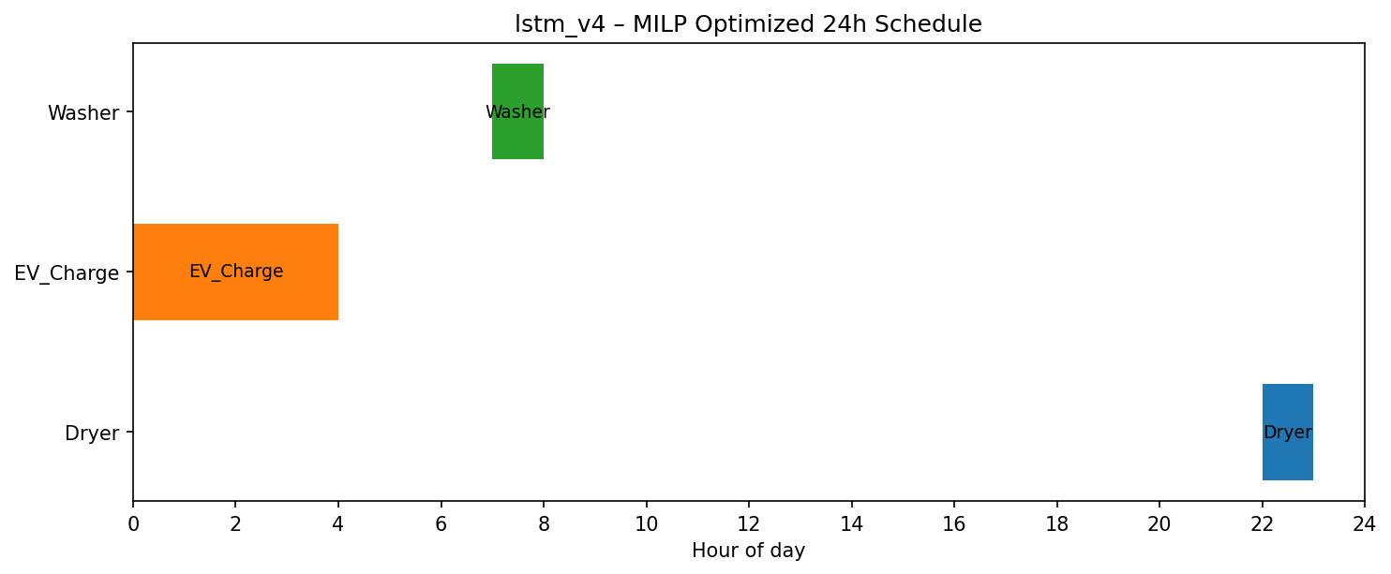
Optimized Schedule (Gantt Chart)
What the Gantt Chart Shows
EV charging shifted to cheapest off-peak hours.
Washer scheduled early evening.
Dryer starts only after Washer finishes (precedence satisfied).
All operations kept under 5 kW cap.

Slide 14
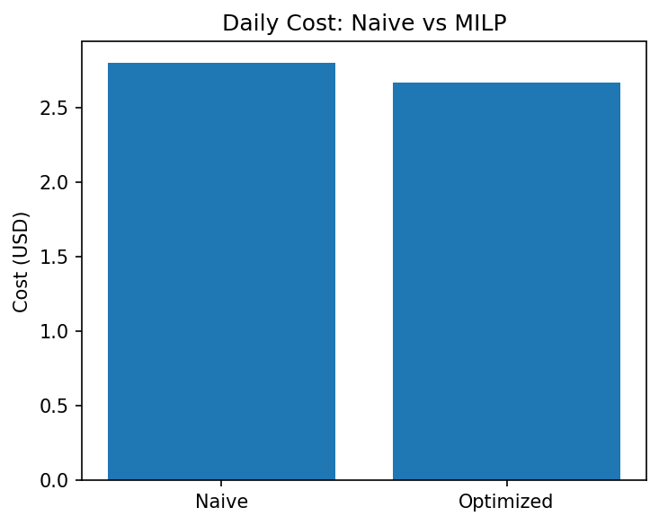
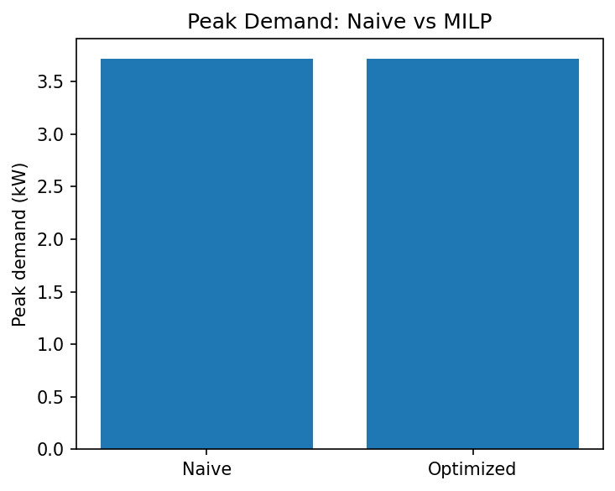
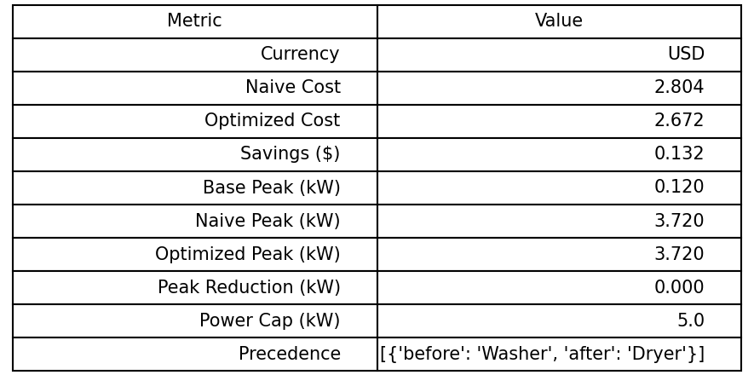
KPI Comparison (Charts & Table)
Key Results
Naive cost: $2.80
MILP cost: $2.67
Savings: $0.132 (≈ 5%)
Peak demand: unchanged (within limit)
Constraints: fully satisfied

Slide 15
Discussion & Limitations
Findings
LSTM effectively predicts daily shape of demand.
MILP optimizer enforces realistic constraints and shifts large loads to cheaper hours.
Demonstrated measurable cost savings.
Limitations
Dataset from a single household (House 1 only).
LSTM could be improved with rolling statistics.
Savings depend heavily on TOU price spread.
No renewable energy integration (solar PV).

Slide 16
Conclusion
Contributions
Built a complete AI pipeline: forecast → optimize → evaluate.
Implemented LSTM + MILP for smart home energy management.
Showed real cost savings and power-limit compliance.
Reproducible via scripts and artifacts.

Slide 17
Future Work
Next Steps
Add rolling mean, lag-24, and anomaly features.
Evaluate multiple households and compare accuracy.
Simulate different tariff models (flat, real-time prices).
Add solar generation and storage (battery).
Deploy interactive dashboard (Streamlit or Dash).

Slide 18
Q&A

